Slide 1

REVIEW PART Ib – HTML Forms
Ranken Technical College

Slide 2
Objectives
Give A Brief HTML Forms Overview
Explain Usage Of Form Tag Attributes
Go Over Basic <form> Tags
Go Over New HTML5 Form Tags
Build And Show An Example Form

Slide 3
HTML Forms Overview
HTML Forms are required when you want to collect data from the site visitor. For example, during user registration you might like to collect information such as name, email address, credit card, etc.

Slide 4
HTML Forms Overview
The form will often take input from a site visitor and validate said input using JavaScript on the client-side. This is done to find any errors on the client, rather than sending bad or incorrect info to a server, only to have it returned back to the client

Slide 5
HTML Forms Overview
The form will then normally take the validated input from the site visitor and post it to a back-end application such as Node.js, ASP.NET or PHP. The back-end application will perform required processing on the passed data based on defined business logic inside the application

Slide 6
<form> Tag Syntax
The HTML <form> tag is used to create an HTML form and it has following syntax:
<form action="ScriptURL" method="GET|POST">
form elements like input, textarea etc.
</form>

Slide 7
<form> Tag Attributes
Attribute Description
action Backend script to process inputted data
method Used to upload data. Most used are GET and POST
enctype Used to specify how the browser encodes
NOTE: These are optional, though action and method are almost always used

Slide 8
Basic <form> Controls
Attribute Description
type Indicates the type of input control
name Name of control, sent to server
id ID of control, used with CSS
value Provides initial value for control
size Width of text-input control
maxlength Max number of user input characters

Slide 9
<label>
This control is often used as a heading for many other controls, e.g. the text input control
<label for="fname">First Name</label>

Slide 10
<label>
This control is often used as a heading for many other controls, e.g. the text input control
<label for="fname">First Name</label>

Slide 11
Single Line Text Input Control
This control is used for items that require only one line of user input, such as search boxes or names. They are created using the HTML <input> tag with type= e.g.: text, password, email, tel
Example:
<input type="text" name="fname" id="fname">

Slide 12
Multi-Line Text Input Control
This control is used for items that require several lines of user input, such as a comment area. They are created using the HTML <textarea> tag
Example:
<textarea name="comments" id="comments"
rows="10" cols="50"></textarea>

Slide 13
<radio> Button Control
This control is typically used for mutually exclusive selections, e.g., Male / Female, etc. They are created using the HTML <input type="radio"> tag
Example:
<input type="radio" name="gender" value="f"> Female
<input type="radio" name="gender" value="m"> Male

Slide 14
<select>…<option> Control
This control is typically used for non-mutually exclusive selections and are created using the HTML <select> and <option> tags
Example:
<select name="cars" id="cars">
<option value="VW Bug">Bug</option>
<option value="Buick">Buick</option>
</select>

Slide 15
File Upload Control
Used to upload a file to a web site. This is created using the HTML <input> element but type attribute is set to file
Example:
<input type="file" id="myFile" name="myFile">

Slide 16
Hidden Control
Used to non-display necessary form field(s), e.g. sales tax. This is created using the HTML <input> element but type attribute is set to hidden
Example:
<input type="hidden"
id="salesTax" name= "salesTax">

Slide 17
Clickable Button Control
Used to create a button which normally has code associated to its click event. This is created using the HTML <input> element but type attribute is set to button
Example:
<input type="button"
id="Click Me" name="Click Me" value="Click Me">

Slide 18
Submit Button Control
Used to create a button which normally submits the form to the server (may validate with JS first). This is created using the HTML <input> element but type attribute is set to submit
Example:
<input type="submit"
id="submit" name="submit" value="Submit">

Slide 19
Reset Button Control
Used to create a button which when clicked, resets form values to their defaults. This is created using the HTML <input> element but type attribute is set to reset
Example:
<input type="reset"
id="reset" name="reset" value="Reset">

Slide 20
HTML5 Datalist Control
The <datalist> tag specifies a list of pre-defined options for an <input> element and provides an "autocomplete" feature
Example:
<datalist id="browsers">
<option value="Firefox">
<option value="Chrome">
</datalist>

Slide 21
HTML5 Output Control
The <output> tag is used to represent the result of a calculation (like one performed by a script)
Example:
<input type="range" id="a" value="50">
+<input type="number" id="b" value="25">
=<output name="x" for="a b"></output>

Slide 22
HTML5 Keygen Control
The keygen element represents a control for generating a public-private key pair and for submitting the public key from that key pair.
Example:
<keygen name="random_key" challenge="0987654321">

Slide 23
HTML5 Progress Control
The progress element specifies the completion progress of a task. It is displayed as a progress bar and can be manipulated by JavaScript
Example:
<progress value="80" max="100"/>

Slide 24
HTML5 Meter Control
The meter element specifies a scalar measurement within a known range (a.k.a. a gauge)
Example:
<meter value="7" min="0" max="10">7 of 10</meter>

Slide 25
HTML Form Example
CSS Part 1:
<style>
body {font-family: Arial, Helvetica, sans-serif;}
* {box-sizing: border-box;}
input[type=text], select, textarea {
width: 100%;
padding: 12px;
border: 1px solid #ccc;
border-radius: 4px;
box-sizing: border-box;
margin-top: 6px;
margin-bottom: 16px;
resize: vertical;
}

Slide 26
HTML Form Example
CSS Part 2:
input[type=submit] {
background-color: #4CAF50;
color: white;
padding: 12px 20px;
border: none;
border-radius: 4px;
cursor: pointer;
}
input[type=submit]:hover {
background-color: #45a049;
}

Slide 27
HTML Form Example
CSS Part 3:
.container {
border-radius: 5px;
background-color: #f2f2f2;
padding: 20px;
}
</style>

Slide 28
HTML Form Example
Body Code Part 1:
<h3>Contact Form</h3>
<div class="container">
<form action="/action_page.php">
<label for="fname">First Name</label>
<input type="text" id="fname" name="firstname" placeholder="Your name..">
<label for="lname">Last Name</label>
<input type="text" id="lname" name="lastname" placeholder="Your last name..">
<label for="country">Country</label>

Slide 29
HTML Form Example
Body Code Part 2:
<select id="country" name="country">
<option value="australia">Australia</option>
<option value="canada">Canada</option>
<option value="usa">USA</option>
</select>
<label for="subject">Subject</label>
<textarea id="subject" name="subject" placeholder="Write something.." style="height:200px"></textarea>
<input type="submit" value="Submit">
</form>
</div>

Slide 30
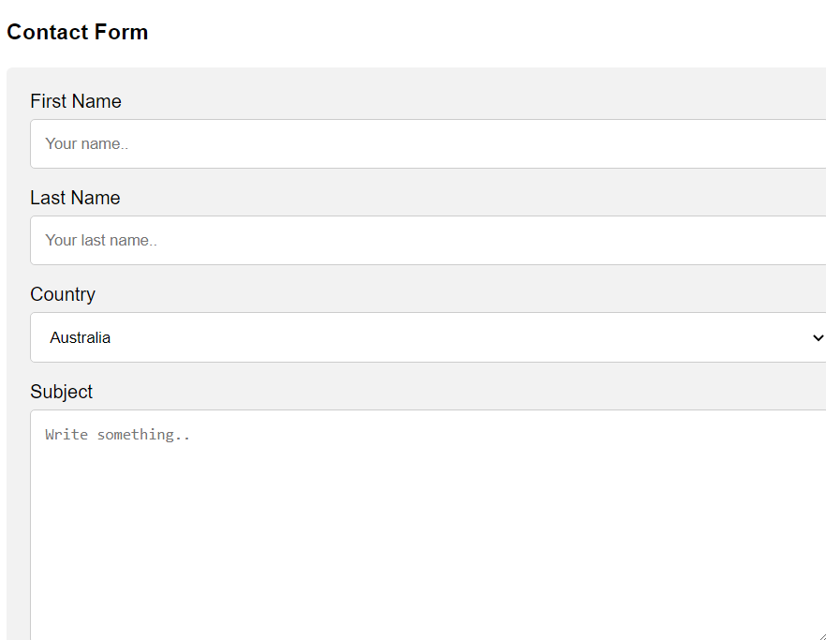
HTML Form Example

Slide 31
What We Covered
HTML Forms Overview
Usage Of Form Tag Attributes
Basic <form> Tags
New HTML5 Form Tags
Example Form

Slide 32
Some Useful URLs
https://www.tutorialspoint.com/html/html_forms.htm
https://www.w3schools.com/html/html_forms.asp
https://html.com/forms/

